Slide 1


Slide 2
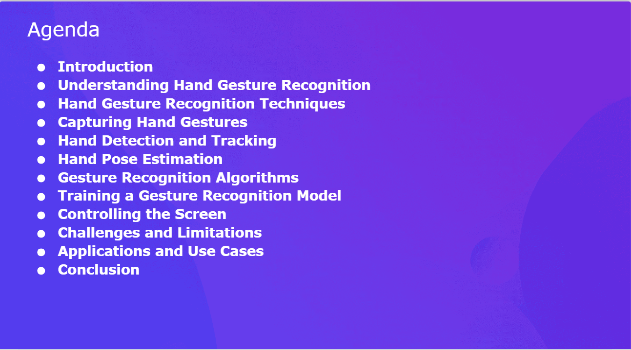

Slide 3
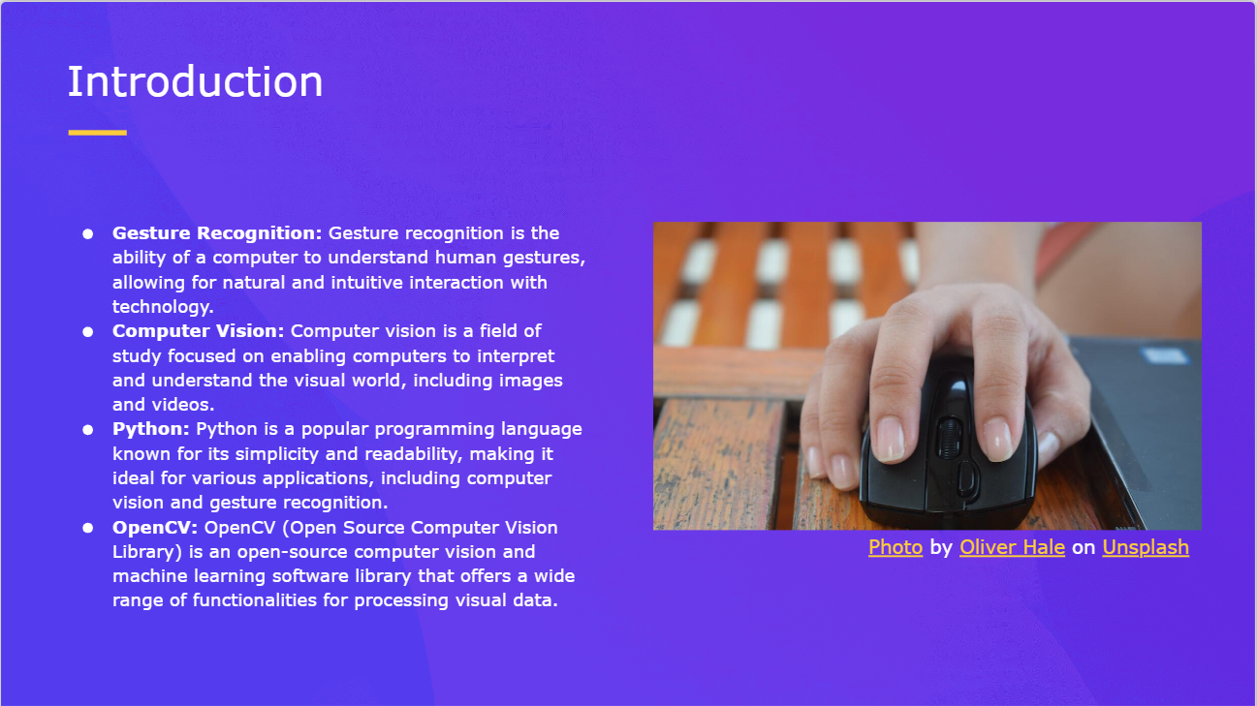

Slide 4
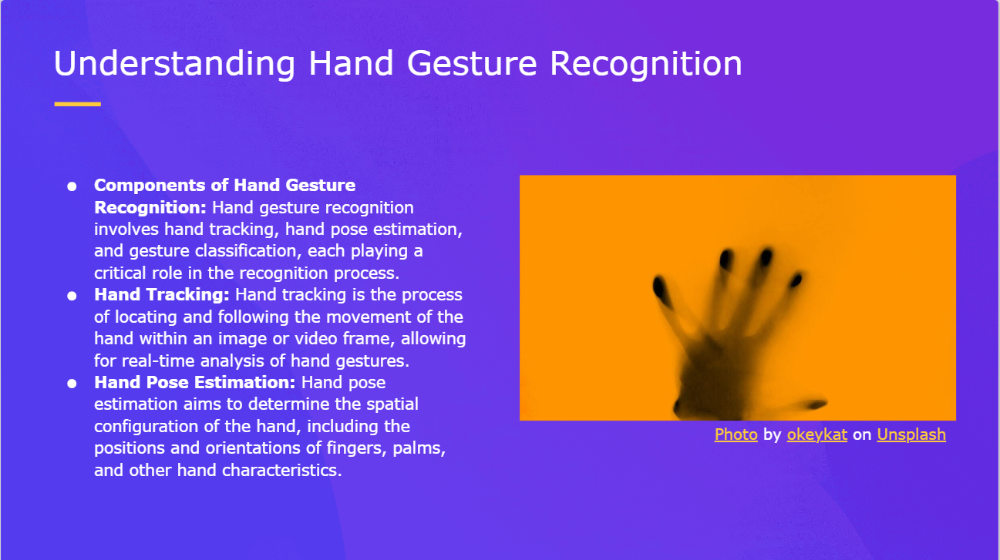

Slide 5
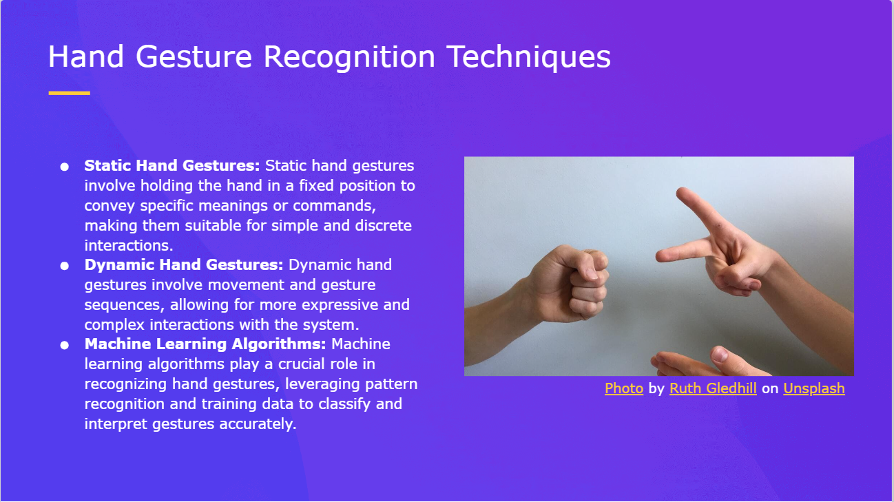

Slide 6
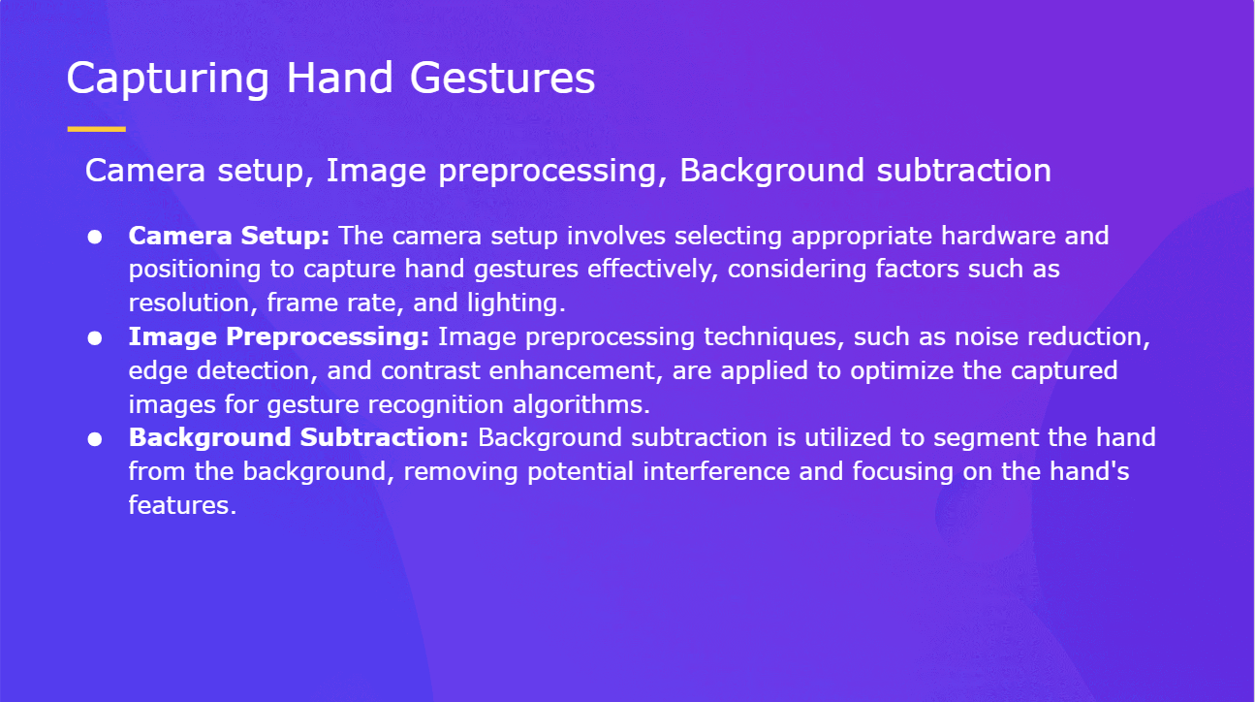

Slide 7
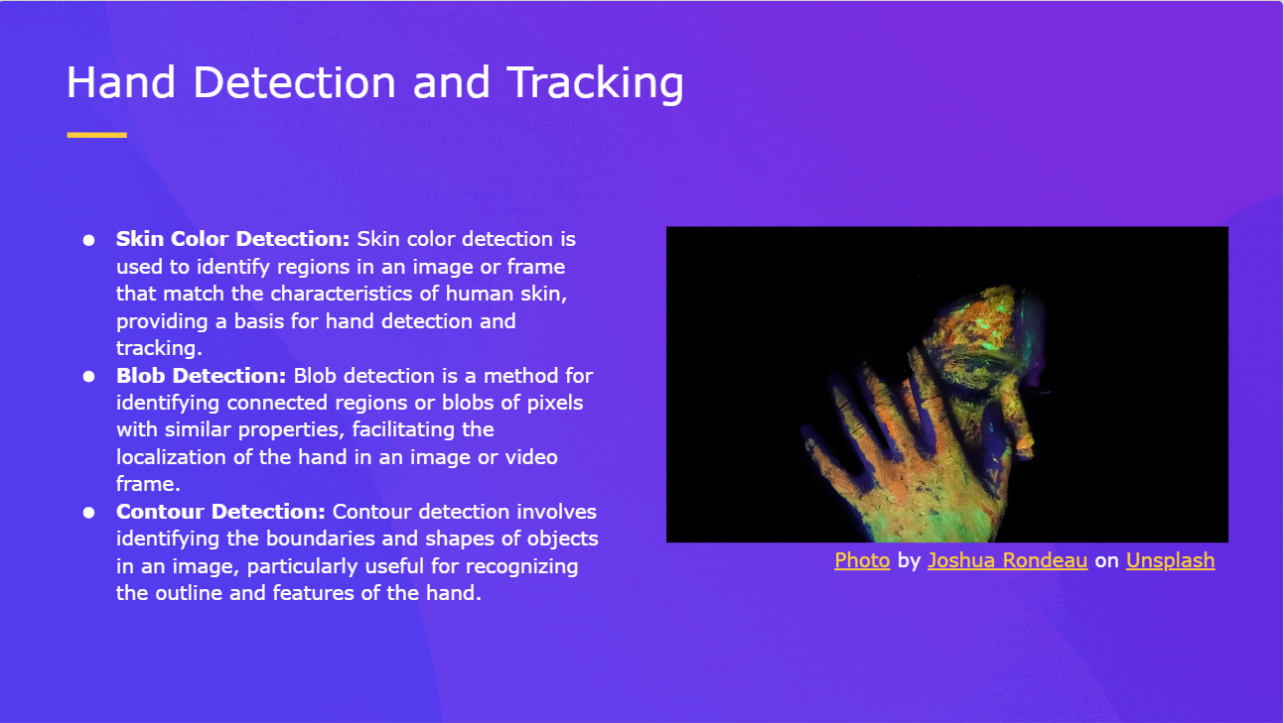

Slide 8
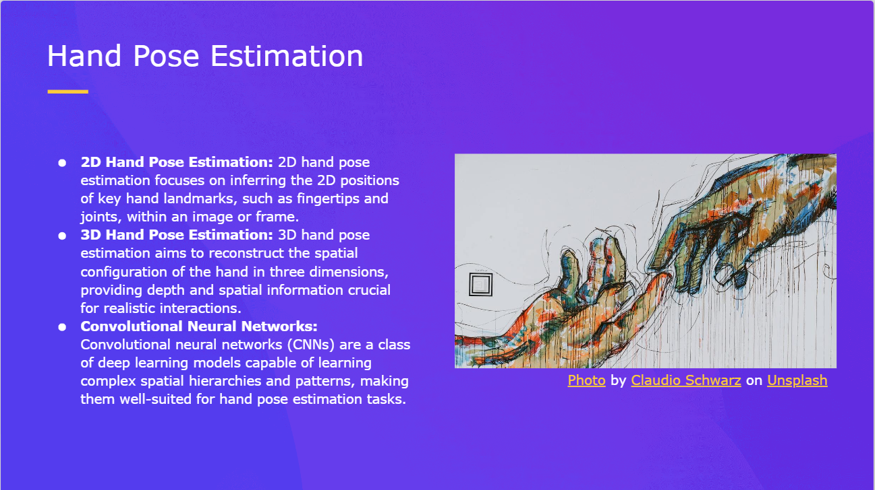

Slide 9


Slide 10


Slide 11


Slide 12
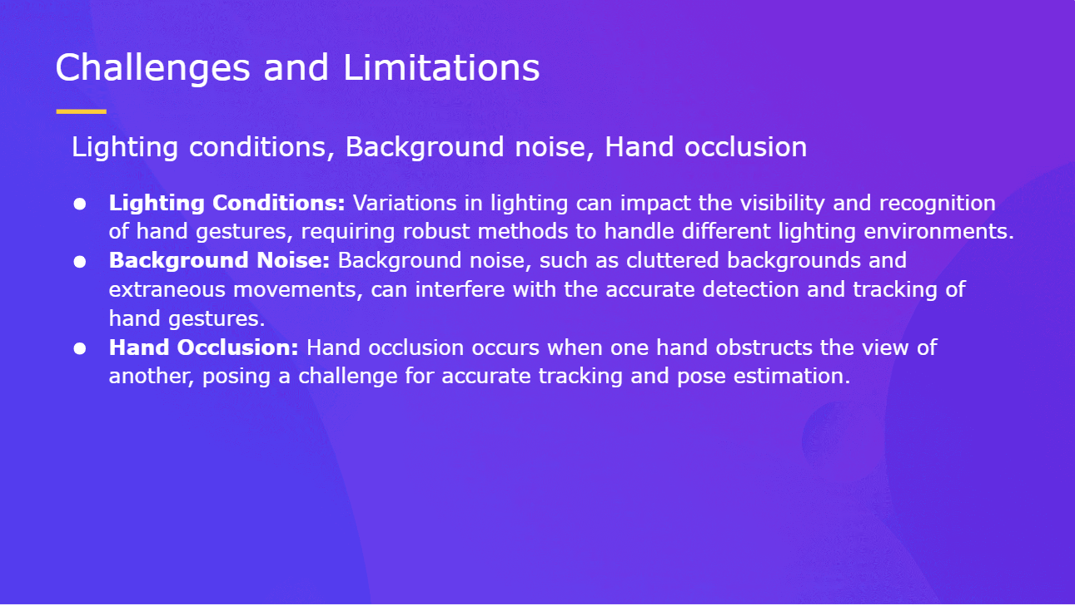

Slide 13
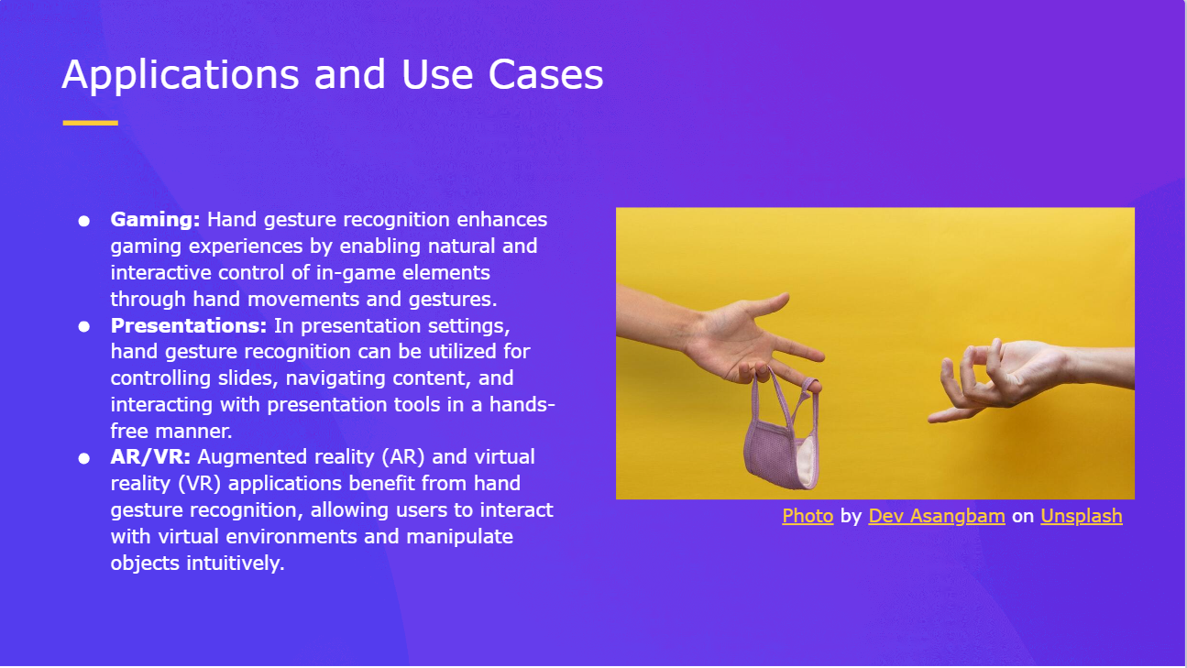

Slide 14


Slide 15
THANK YOU
NAME:RAJKAMAL RAJASEKAR
COLLEGE: Rajalakshmi Engineering College
DEPT: Computer science engineering
E-MAIL: 210701204@rajalakshmi.edu.in

